Slide 1
CANDIDATE PERSONAS
Where Research Meets Marketing
Susanna Frazier @ohsusannamarie
Head of Strategic Sourcing Universal Music Group

Slide 2
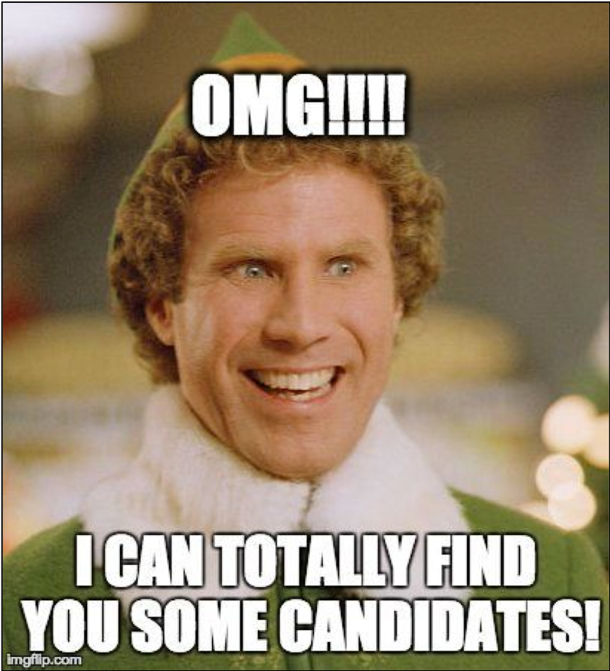

Slide 3
AGENDA
Introduction to Candidate Personas
Market Research: How to Understand Your Target Audience
Market Positioning: How to Seduce Your Target Talent
Direct Sourcing: How to Execute Your Targeted Strategies

Slide 6
Market Positioning
Direct Sourcing
Market Research

Slide 8
MARKET RESEARCH GOALS
Understand your target audience, including their top drivers of attraction and retention.
01
Customize and articulate your EVP accordingly.
02

Slide 9
Job Title Research

Slide 10
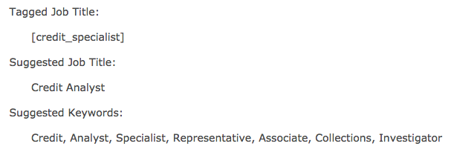

Slide 12
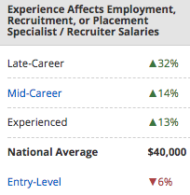
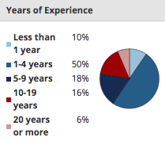
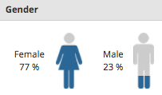
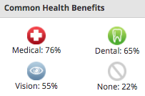

Slide 13
Company Research

Slide 14
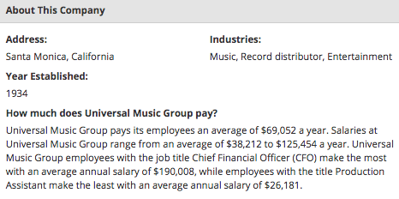
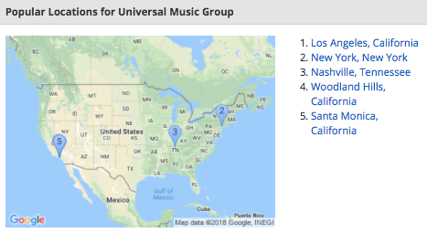
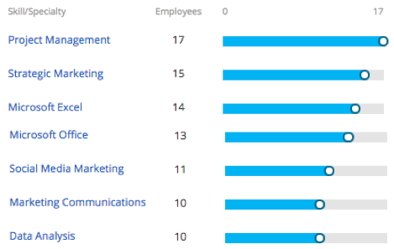
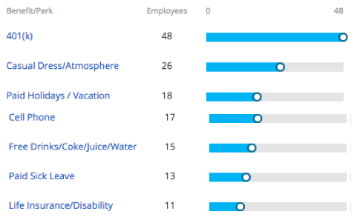

Slide 15
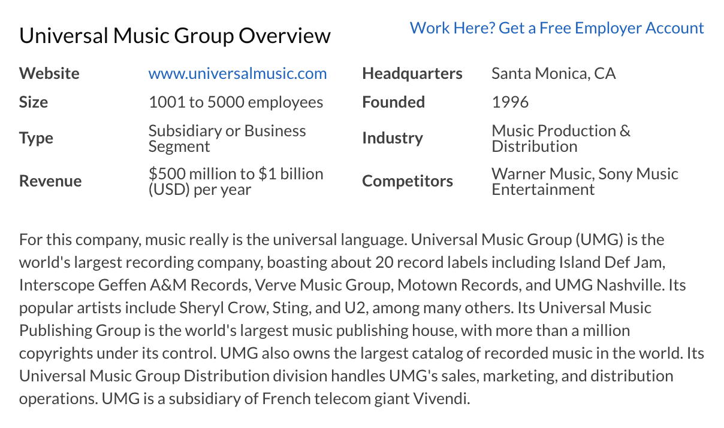
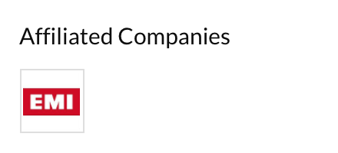
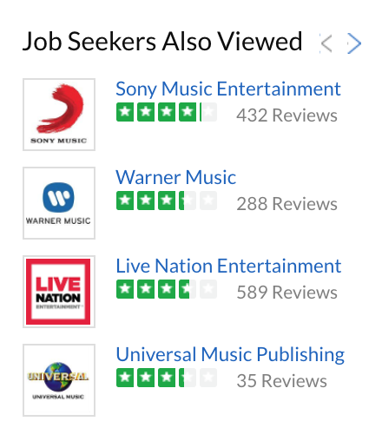

Slide 17
Job Title + Company Research

Slide 19
Drivers of Employee Retention & Attraction

Slide 20
TOP DRIVERS OF EMPLOYEE RETENTION
Base pay / salary
Career advancement opportunities
Physical work environment
Job security
Ability to manage work-related stress
Relationship with supervisor / manager
Trust / Confidence in senior leadership

Slide 21
TOP DRIVERS OF EMPLOYEE ATTRACTION
Base pay / salary
Job security
Career advancement opportunities
Challenging work
Opportunities to learn new skills
Reputation of organization as a great place to work
Healthcare and wellness benefits

Slide 22
MARKET POSITIONING GOALS
Attract top talent to read your content.
01
Engage with readers about your job.
02

Slide 23
Content Optimization

Slide 24
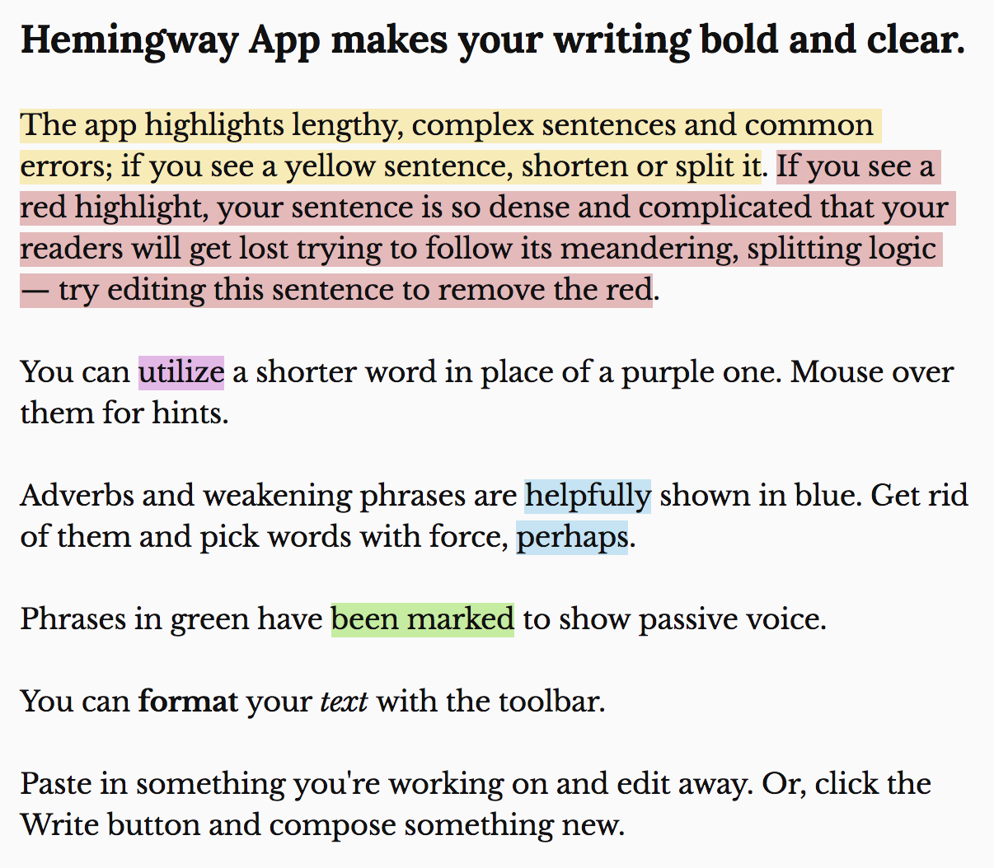
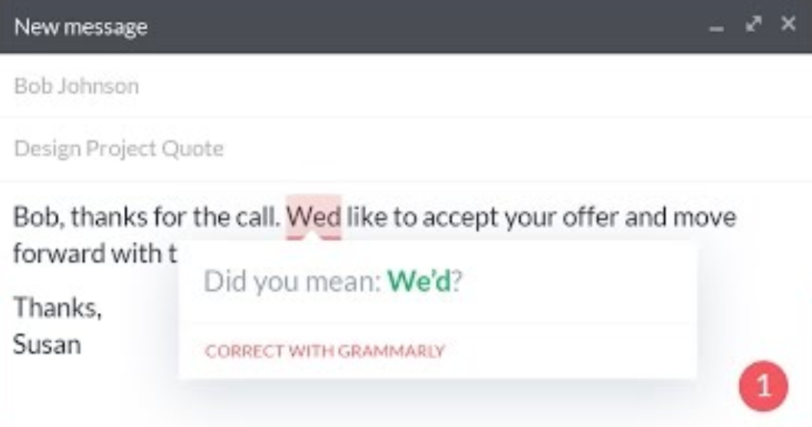
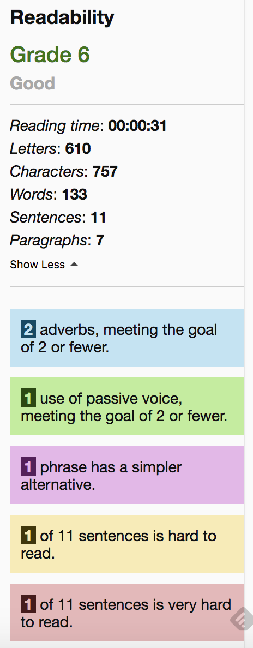

Slide 25
JOB OPTIMIZATION

Slide 26
Job Optimization

Slide 29
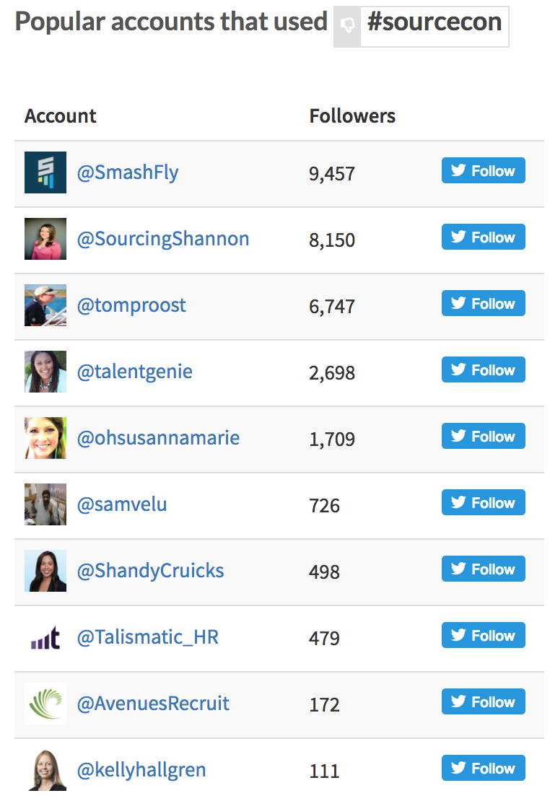
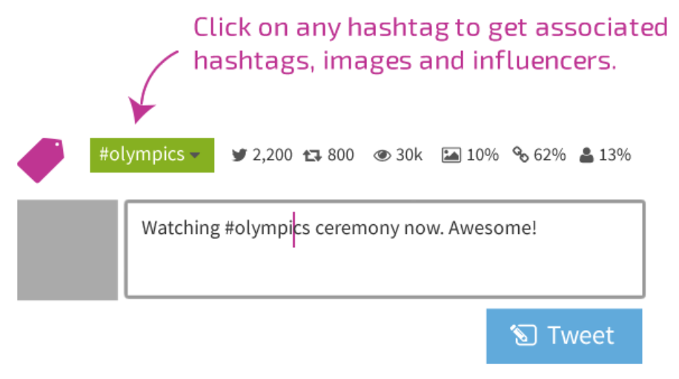
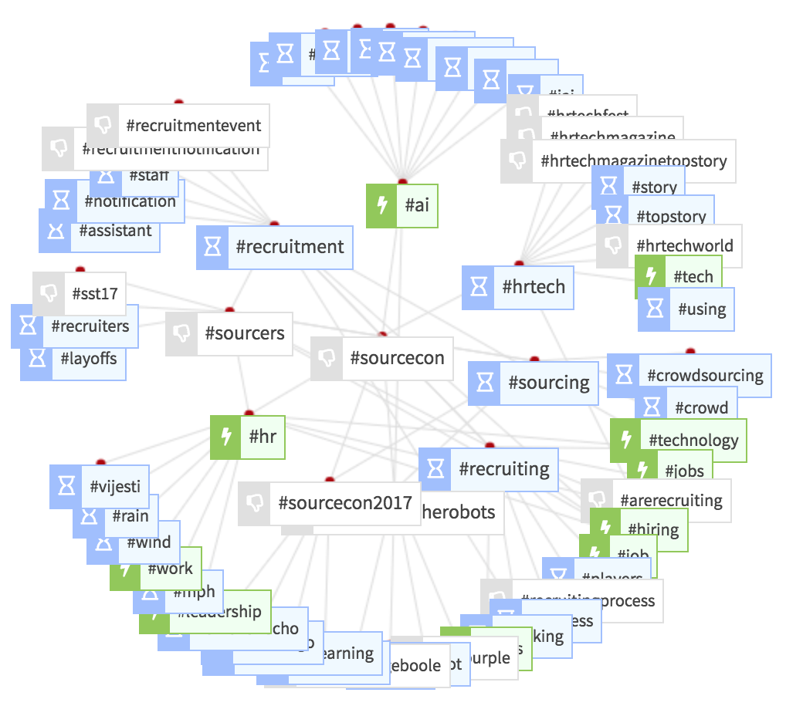
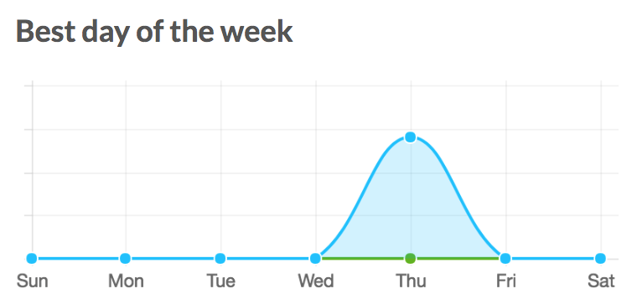
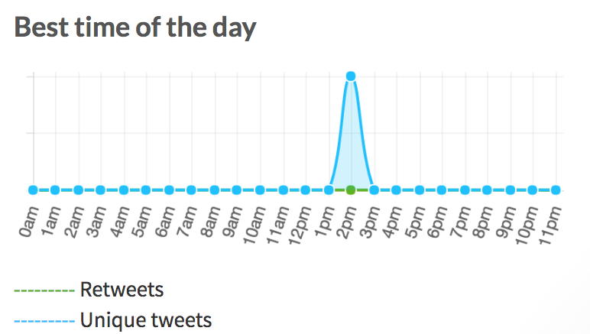

Slide 30
Outreach Optimization

Slide 31
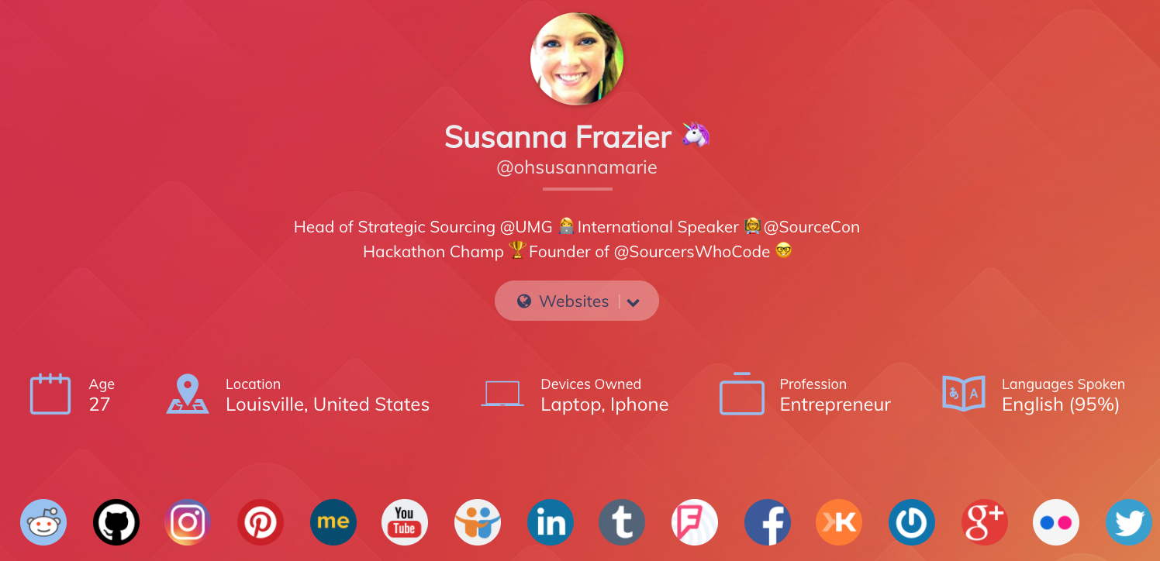
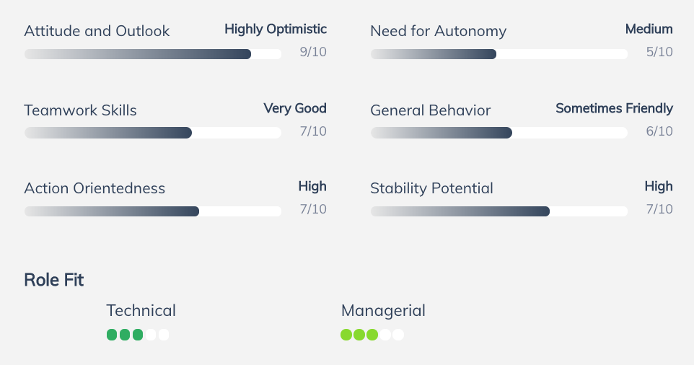
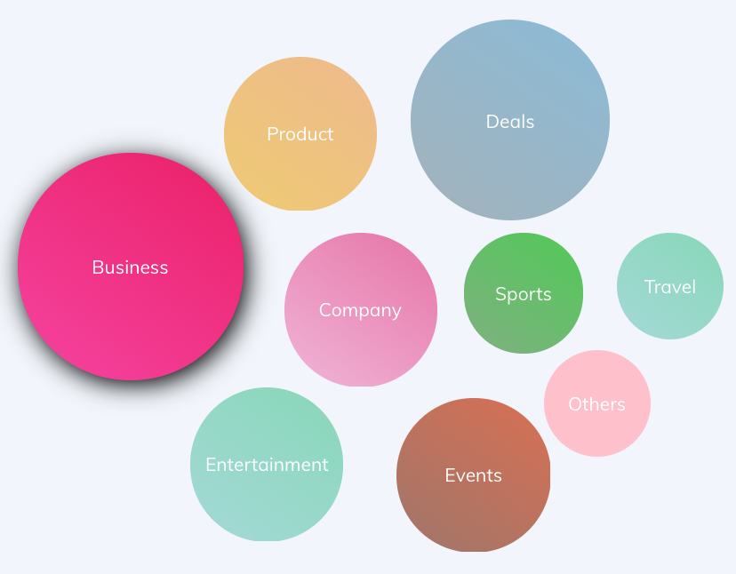
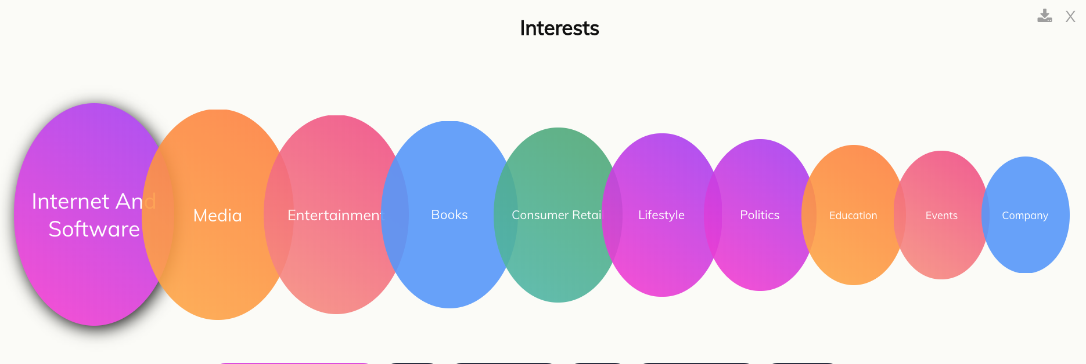

Slide 33
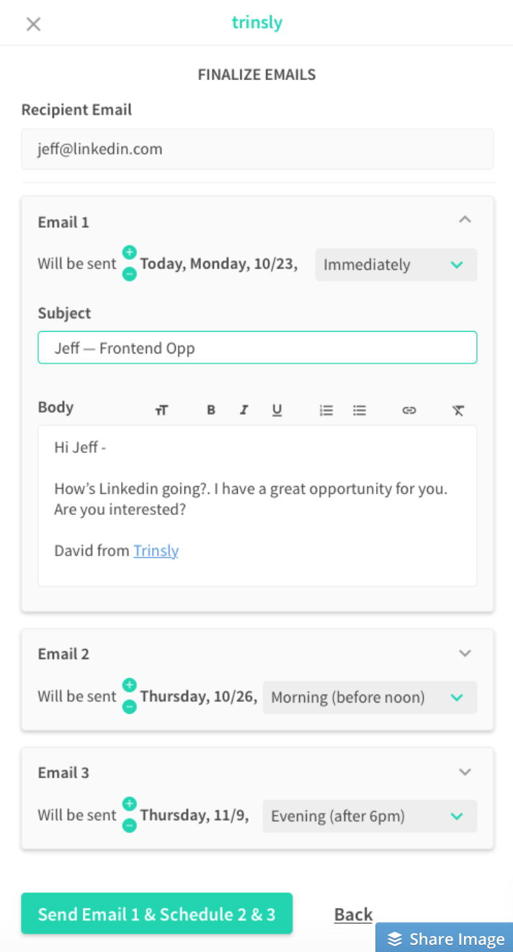
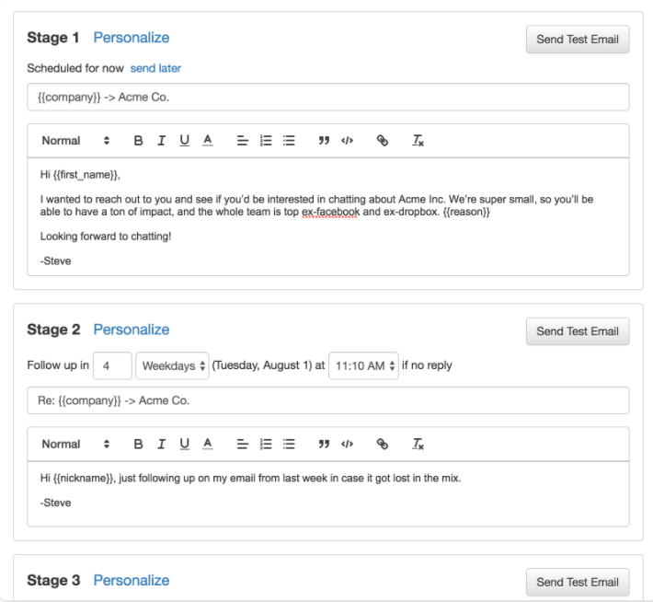
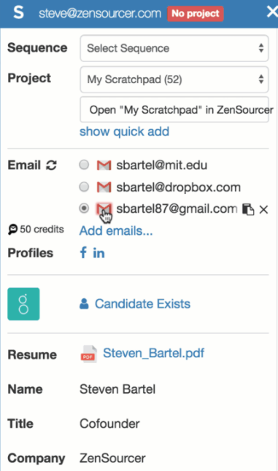
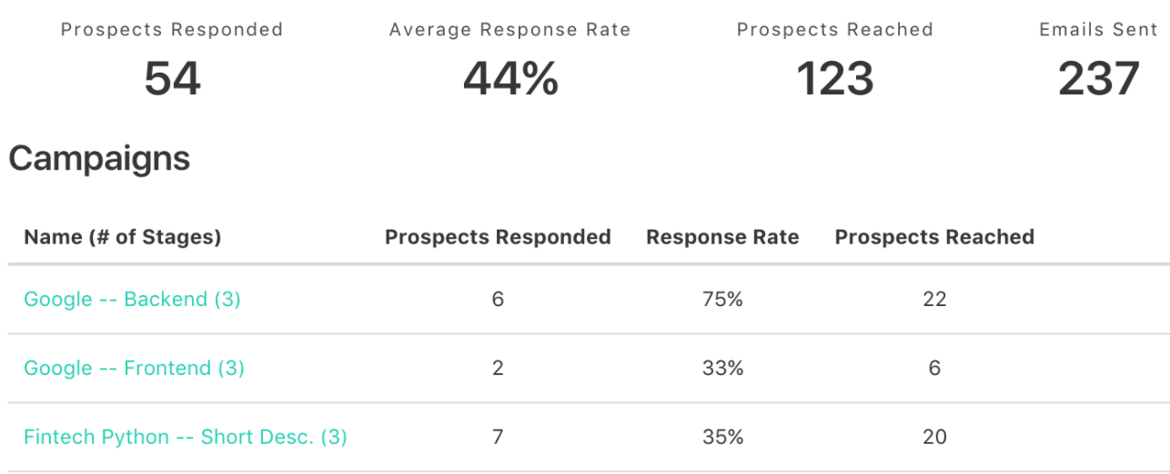

Slide 35
DIRECT SOURCING GOALS
Execute targeted search strategies.
01
Generate high-quality candidates for consideration.
02

Slide 36
Boolean Builders

Slide 37
Site-Specific Search

Slide 38
X-Ray Search

Slide 39
Saved Searches

Slide 40
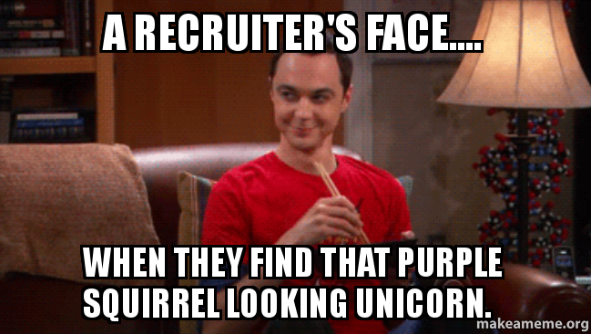

Slide 41
LET’S CONNECT!

